Slide 1
CCNA 200-301 Volume I
Chapter 19 Understanding OSPF Concepts

Slide 2
Objectives
Comparing Dynamic Routing Protocol Features
OSPF Concepts and Operation
OSPF Areas and LSAs

Slide 3
Comparing Dynamic Routing Protocol Features
Routing protocol: A set of messages, rules, and algorithms used by routers for the overall purpose of learning routes. This process includes the exchange and analysis of routing information. Each router chooses the best route to each subnet (path selection) and finally places those best routes in its IP routing table. Examples include RIP, EIGRP, OSPF, and BGP.
Routed protocol and routable protocol: Both terms refer to a protocol that defines a packet structure and logical addressing, allowing routers to forward or route the packets. Routers forward packets defined by routed and routable protocols. Examples include IP Version 4 (IPv4) and IP Version 6 (IPv6).

Slide 4
Routing Protocol Functions
Learn routing information about IP subnets from neighboring routers.
Advertise routing information about IP subnets to neighboring routers.
If more than one possible route exists to reach one subnet, pick the best route based on a metric.
If the network topology changes—for example, a link fails—react by advertising that some routes have failed and pick a new currently best route. (This process is called convergence.)

Slide 5
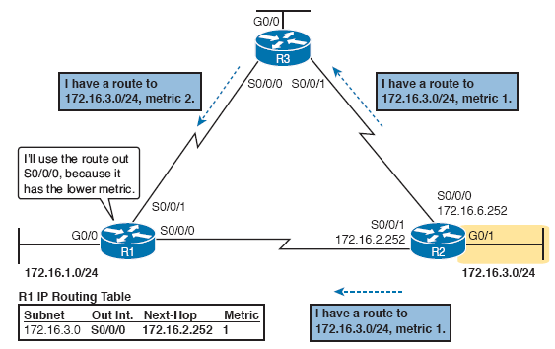
Routing Protocol Functions

Slide 6
Interior and Exterior Routing Protocols
There are two major categories of IP routing protocols:
IGP: A routing protocol that was designed and intended for use inside a single autonomous system (AS)
EGP: A routing protocol that was designed and intended for use between different autonomous systems
An Autonomous System (AS) is a network under the administrative control of a single organization.
Some routing protocols work best inside a single AS by design, these are called IGPs
Other routing protocols work best between ASs by design, these are called EGPs

Slide 7
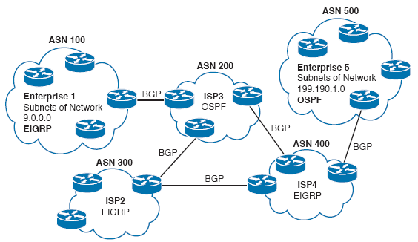
Comparing Locations for Using IGPs and EGPs

Slide 8
IGP Routing Protocol Algorithms
There are three main branches of routing protocol algorithms:
Distance vector (sometimes called Bellman-Ford after its creators)
Advanced distance vector (sometimes called “balanced hybrid”)
Link-state
Distance vector protocols were invented first (RIP and IGRP).
Link state protocols (OSPF and IS-IS) and advanced distance vector protocols (EIGRP) came later.

Slide 9
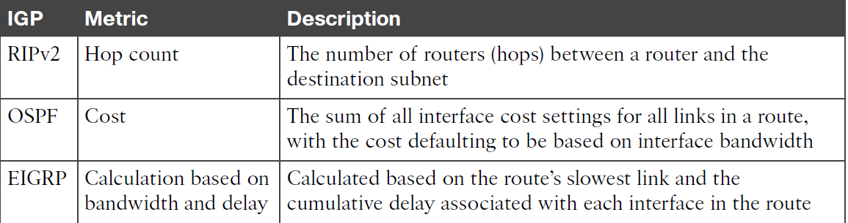
IGP Routing Protocol Metrics
Routing protocols choose the best route to reach a subnet by choosing the route with the lowest metric.

Slide 10
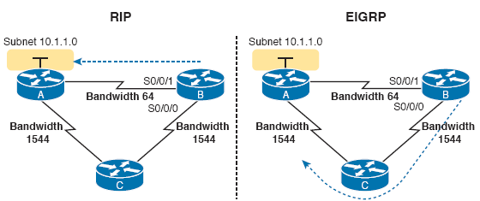
IGP Routing Protocol Algorithms
This example shows why OSPF/EIGRP surpassed RIP; it shows Router B with two possible routes to subnet 10.1.1.0:
A shorter route over a very slow 64-Kbps link
A longer route over two higher-speed (T1) links
With EIGRP selecting the better choice even though it goes through multiple routers.

Slide 11
Other IGP Comparisons
Feature | RIPv1 | RIPv2 | EIGRP | OSPF | IS-IS
Classless/sends mask in updates/supports VLSM | No | Yes | Yes | Yes | Yes
Algorithm (DV, advanced DV, Link State) | DV | DV | adv. DV | LS | LS
Supports manual summarization | No | Yes | Yes | Yes | Yes
Cisco-proprietary | No | No | Yes | No | No
Routing updates are sent to a multicast IP address | No | Yes | Yes | Yes | --
Convergence | Slow | Slow | Fast | Fast | Fast

Slide 12
Administrative Distance
When two different routing protocols learn routes to the same subnet, IOS cannot compare the metrics.
When IOS must choose between routes learned using different routing protocols it uses a concept called administrative distance.
Administrative distance is a number that denotes how believable an entire routing protocol is, on a single router.

Slide 13
Administrative Distance
Route Type | Administrative Distance
Connected | 0
Static | 1
BGP (External routes) | 20
EIGRP (Internal routes) | 90
IGRP | 100
OSPF | 110
IS-IS | 110
RIP | 120
EIGRP (External routes) | 170
BGP (Internal routes) | 200
DHCP default route | 254
Unusable | 255

Slide 14
OSPF Overview
Link State protocols build IP routes with a couple of major steps:
The routers learn a lot of information about the network (Routers, links, IP addresses, status information, etc.)
The routers then flood this information so that all routers know the same information.
Each router can then calculate routes to all subnets from their own perspectives.

Slide 15
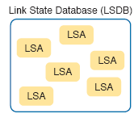
Topology Information and LSAs
OSPF organizes topology information using LSAs and the link-state database (LSDB).
Each LSA is a data structure with some specific information about the network topology.
The LSDB is a collection of all the LSAs known to a router.

Slide 16
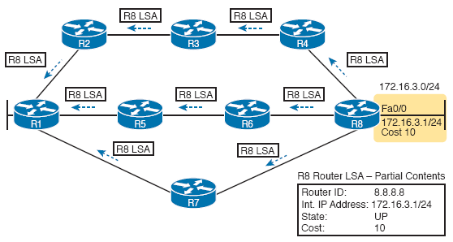
Topology Information and LSAs
The flooding process has a way to prevent loops so that the LSAs do not get flooded around in circles:
Before sending an LSA to yet another neighbor, routers communicate which LSAs they already have.
Only LSAs that are not known are flooded.
Routers reflood LSA information based on the LSAs separate aging timer (default 30 minutes).

Slide 17
Applying Dijkstra Math to Find the Best Routes
To build routes, link state routes have to do some math based on the topological information found in the LSDB.
All link state protocols use a math algorithm called Dijkstra Shortest Path First (SPF) to process the LSDB.
The algorithm analyzes the LSDB and builds the routes that the local route will add to the IP routing table.

Slide 18
Becoming OSPF Neighbors
OSPF neighbors are routers that both use OSPF and both sit on the same data link.
OSPF routers introduce themselves by sending Hello messages.
Assuming the two neighbors have compatible OSPF parameters, the two will form a neighbor relationship.
The OSPF neighbor relationship lets OSPF know when a neighbor might not be a good option for routing packets.
The OSPF neighbor model allows new routers to be dynamically discovered.

Slide 19
Meeting Neighbors and Learning Their Router-ID
When OSPF exchanges Hello messages they list each router’s router-id (RID).
This RID serves as each router’s unique name or identifier for OSPF.
OSPF RIDs are 32-bit numbers.
IOS chooses its OSPF RID based on an active interface IPv4 address.
The OSPF RID can also be directly configured.
As soon as a router has chosen its OSPF RIS and some interfaces come up, the router is ready to meet its OSPF neighbors.

Slide 20
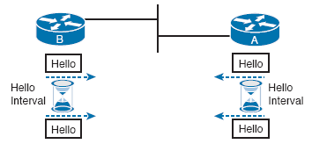
Meeting Neighbors and Learning Their Router-ID
To discover other OSPF-speaking routers, a router sends multicast OSPF Hello packets to each interface and hopes to receive OSPF hello packets from other routers connected to those interfaces.

Slide 21
Meeting Neighbors and Learning Their Router-ID
The Hello message follows the IP packet header, with IP protocol type 89.
Hello packets are sent to multicast IP address 224.0.0.5, a multicast IP address intended for all OSPF-speaking routers.
OSPF routers listen for packets sent to IP multicast address 224.0.0.5, in part hoping to receive Hello packets and learn about new neighbors.

Slide 22
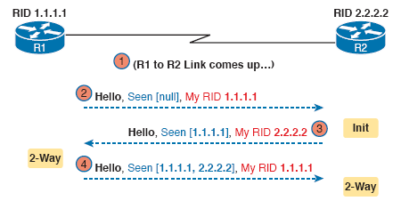
Early Neighbor States
The 2-way state is a particularly important OSPF state, when in this state the following statements are true:
The router received a Hello from the neighbor, with that router’s own RID listed as being seen by the neighbor.
The router has checked all the parameters in the Hello received from the neighbor, with no problems. The router is willing to become a neighbor.
If both routers reach a 2-way state with each other, it means that both routers meet all OSPF configuration requirements to become neighbors. Effectively, at that point, they are neighbors, and ready to exchange their LSDB with each other.

Slide 23
Fully Exchanging LSAs with Neighbors
After two routers decide to exchange databases, they do not simply send the contents of their entire database:
They tell each other a list of LSAs that are in their respective databases,
Each router checks to see which LSAs it already has,
Each router then requests only those LSAs that it does not know about yet,
OSPF messages that actually send the LSAs between neighbors are called Link-State Update (LSU) packets.
Each LSU packet holds data structures called Link State Advertisements (LSA).

Slide 24
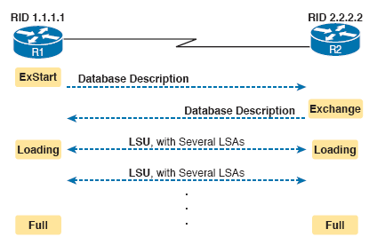
OSPF Database Exchange
When finished, the routers reach a full state, meaning they have fully exchanged the contents of their LSDBs

Slide 25
Maintaining Neighbors and the LSDB
Once two neighbors reach a full state, they have done all the initial work to exchange OSPF information.
Neighbors still have to do some small ongoing tasks to maintain their neighbor relationship:
Routers monitor each neighbor relationship using Hello messages and two related timers: Hello Interval and Dead Interval.
Routers send and expect to receive a Hello message from each neighbor based on the Hello interval.
If a neighbor is silent for the length of the Dead Interval, the router assumes the neighbor has failed.
Routers must also be able to react when the topology changes.

Slide 26
OSPF Maintenance Task Summary
Maintain neighbor state by sending Hello messages based on the Hello Interval, and listening for Hellos before the Dead Interval expires.
Flood any changed LSAs to each neighbor.
Reflood unchanged LSAs as their lifetime expires (default 30 minutes).

Slide 27

Designated Routers on Ethernet Links
On Ethernet links, OSPF elects one of the routers on the same subnet to act as the designated router (DR).
The DR plays a key role in how the database exchange process works.

Slide 28
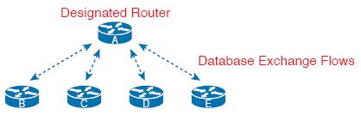
Designated Routers on Ethernet Links
The database exchange process on an Ethernet link does not happen between every pair of routers on the same VLAN/subnet.
The database exchange happens between the DR and each of the other routers.
The backup designated router (BDR) watches the status of the DR and takes over for the DR if it fails.
The DR and BDR both do full database exchanges with all other routers on the LAN, they both reach a full state with all neighbors.

Slide 29
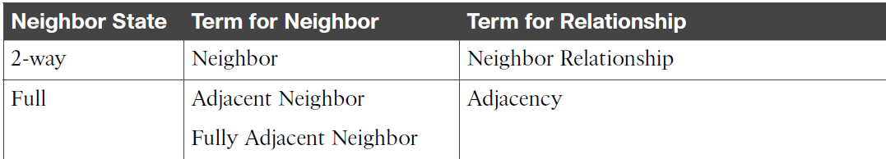
Stable OSPF Neighbor States and Their Meanings

Slide 30
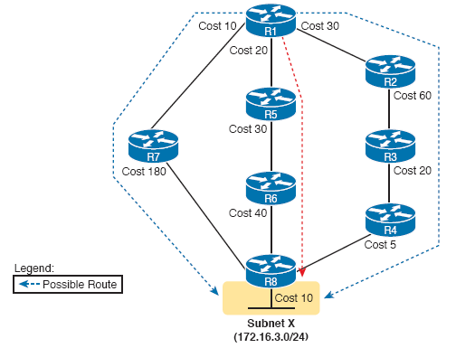
Calculating the Best Routes with SPF
Once SPF has identified a route, OSPF calculates the metric for a route as follows:
The sum of the OSPF interface costs for all outgoing interfaces in the route.

Slide 31
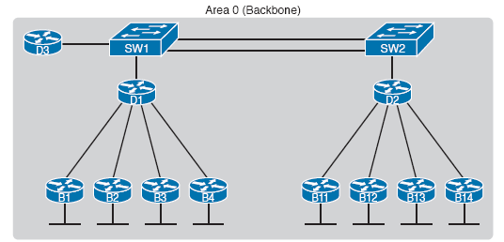
OSPF Area Design
Larger OSPFv2 networks suffer when using a single area design:
A larger topology database requires more memory on each router.
Processing the larger topology database with the SPF algorithm requires processing power that grows exponentially with the size of the topology database.
A single interface status change, anywhere in the internetwork (up to down, or down to up), forces every router to run SPF again!

Slide 32
OSPF Area Design
The solution is to take one large LSDB and break it into several smaller LSDBs by using OSPF areas.
With areas each link is placed into one area.
SPF does its complicated match on the topology inside the areas and that area’s topology alone.
Generally, networks larger then a few dozen routers benefit from areas.

Slide 33
OSPF Areas
OSPF area design follows a couple of basic rules:
Put all interfaces connected to the same subnet inside the same area.
An area should be contiguous.
Some routers may be internal to an area, with all interfaces assigned to that single area.
Some routers may be Area Border Routers (ABR), because some interfaces connect to the backbone area, and some connect to nonbackbone areas.
All nonbackbone areas must connect to the backbone area (area 0) by having at least one ABR connected to both the backbone area and the nonbackbone area.

Slide 34
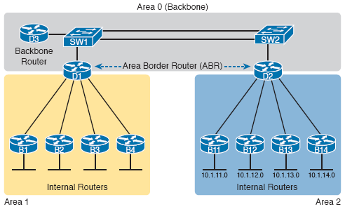
OSPF Areas

Slide 35
OSPF Design Terminology
Term | Description
Area Border Router (ABR) | An OSPF router with interfaces connected to the backbone area and to at least one other area
Backbone Router | A router connected to the backbone area (includes ABRs)
Internal Router | A router in one area (not the backbone area)
Area | A set of routers and links that share the same detailed LSDB information, but not with routers in other areas, for better efficiency
Backbone Area | A special OSPF area to which all other areas must connect—area 0
Intra-area route | A route to a subnet inside the same area as the router
Inter-area route | A route to a subnet in an area of which the router is not a part

Slide 36
How Areas Reduce SPF Calculation Time
SPF spends most of the its processing time working through all the topology details.
Areas reduce this workload because the LSDB only lists those routers and links inside that area.
While the LSDB has less topology information, it still has to have information about all subnets in all areas.
OSPF uses very brief summary information about the subnets to other areas.
These LSAs do not include topology information about the other areas.

Slide 37
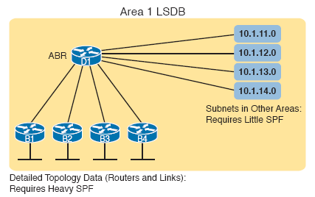
How Areas Reduce SPF Calculation Time

Slide 38
OSPF Area Design Advantages
The smaller per-area LSDB requires less memory.
Routers require fewer CPU cycles to process the smaller per-area LSDB with the SPF algorithm, reducing CPU overhead and improving convergence time.
Changes in the network (for example, links failing and recovering) require SPF calculations only on routers connected to the area where the link changed state, reducing the number of routers that must rerun SPF.
Less information must be advertised between areas, reducing the bandwidth required to send LSAs.

Slide 39
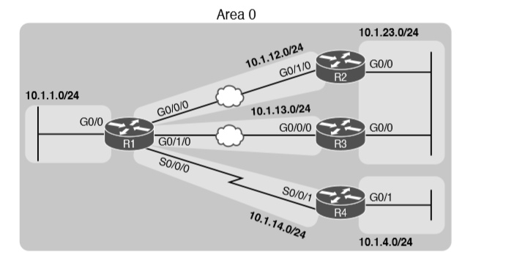
Enterprise Network with Seven IPv4 Subnets

Slide 40
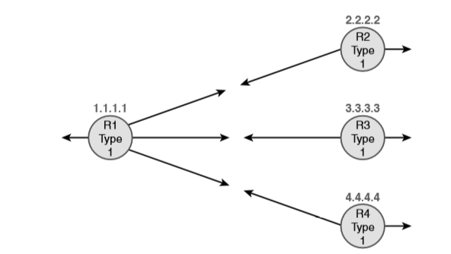
Type 1 LSAs, Assuming a Single-Area Design

Slide 41
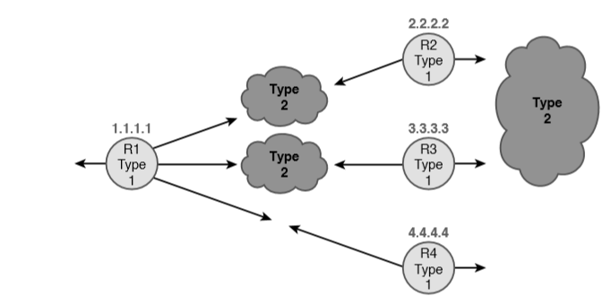
Type 1 and Type 2 LSAs in Area 0, Assuming a Single-Area Design

